Slide 1
Copyright © 2014 by Software Craftsmanship Guild.
All rights reserved. No part of these materials may be reproduced, distributed, or transmitted in any form or by any means, including photocopying, recording, or other electronic or mechanical methods, without the prior written permission of the Software Craftsmanship Guild. For permission requests, write to the Software Craftsmanship Guild, addressed “Attention: Permissions Coordinator,” at the address below.
Software Craftsmanship Guild
526 S. Main St, Suite 609
Akron, OH 44311

Slide 2
Intro to Data Definition Language (DDL)
Software Craftsmanship Guild

Slide 3
Lesson Goals
Learn how to create database and tables
Learn to configure primary keys
Learn to define relationship constraints
Learn about the basic data types available in SQL Server

Slide 4
Creating a New Database
We have the option to create new databases either through the Management Studio interface or with SQL.
The management studio interface is a wizard:
Right Click the Databases folder in the explorer, and choose ‘new database’
Most wizard windows in SQL Server have a scripts button that allows your choices to be scripted. This is a great option for saving SQL syntax for later

Slide 5
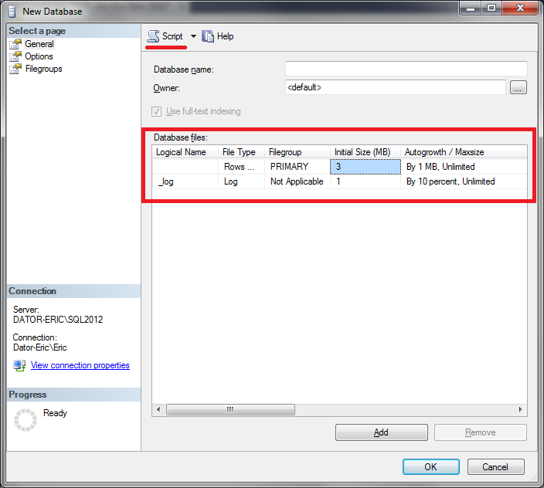

Slide 6
Once we name our database…
We should set the recovery model. Which model you choose will determine how backups and restores work. We will only concern ourselves with two
Simple- There are no log backups and space in the log is automatically managed so there is no need to free up transaction log space. However any changes since the last backup will be lost.
Full – Requires log backups. You can recover up to a point in time and typically there will be little to no data lost in a recovery situation

Slide 7
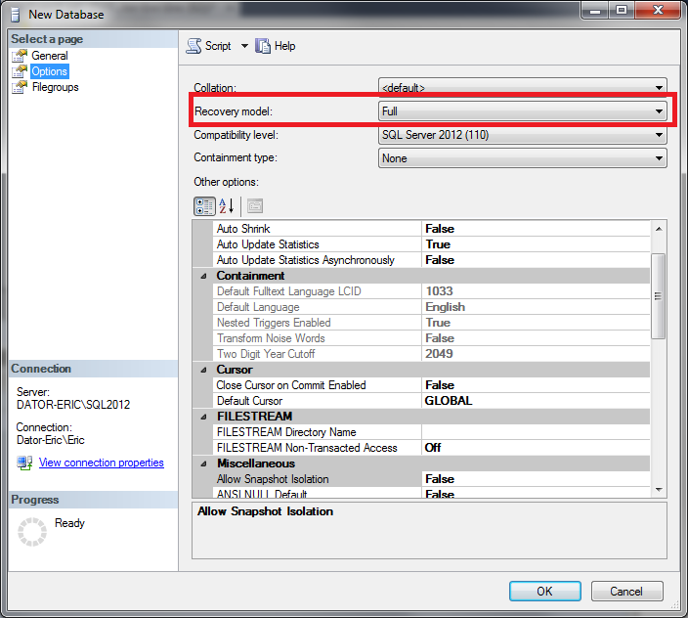

Slide 8
File Groups
These let you separate data across multiple disks for performance reasons. We won’t be covering this in the beginner’s course.
Consult an experienced DBA before messing with this.

Slide 9
Wait a tick, what the heck is a log? Why does SQL think it’s so important?
Every SQL Server database has a transaction log that records all transactions and the database modifications made by each transaction.
This means every time you make a change to data there are 3 writes:
The action to occur
The real data modification
The commit that the real data has been updated
In this way if you submit a modification to the data and someone kicks the cord out of the server in the middle, the database can see uncommitted transactions in the log and roll them back, preserving the clean state of your data!

Slide 10
So what logging strategy should I choose?
Typically full for production with frequent (depends on loss tolerance of the business) log backups
In development, we usually use simple because a nightly backup is sufficient.

Slide 11
Common Log SNAFUs by Developers
Not backing up the log
Since SQL Server needs it to recover, it won’t overwrite the log unless it gets backed up. So if you forget your log will grow forever until you run out of disk space someday.
Putting the log on the same drive as the data
Can you say write contention? I knew you could.

Slide 12
Creating Tables
To Create a table we can either right click the Tables folder in our database or write a CREATE TABLE script.
Let’s look at the wizard first

Slide 13
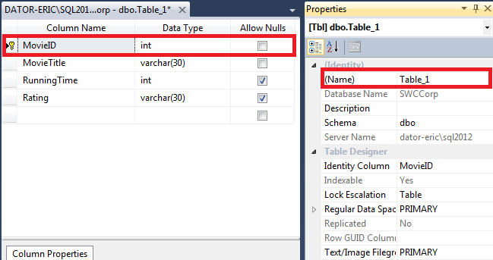
Create Table in SSMS
We can enter column names and Data Types for the columns, as well as tell SQL Server whether they are required (Allow Nulls Unchecked).
The properties window allows us to set a table name and we can right click on a column to set it as a primary key

Slide 14
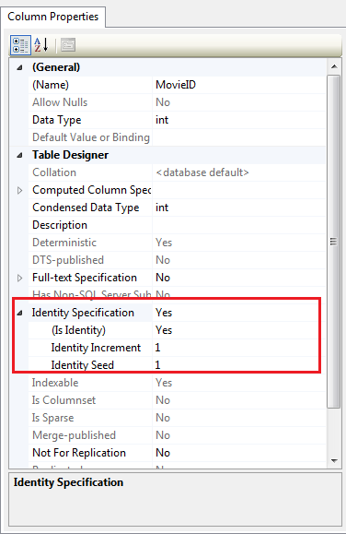
Column Properties
The column properties has a variety of advanced functions, but I want to draw your attention to the Identity Specification property.
If set to yes, this instructs SQL Server to manage the column and automatically increment the field.
The Identity Increment is how many numbers between values (right now it will count up by 1)
The Identity Seed is the starting number (sometimes companies like to do things like start invoices at 1000)
We most often set identity columns as primary keys

Slide 15
Why AutoNumbers For Keys?
There are several reason why this is typical
Privacy- Keys often have to be referenced in code, so we don’t like to use personal data (like social security number) because it isn’t safe to put into website urls, etc.
Fragmentation- The primary key by default exists as a Clustered Index
A clustered index is the physical order of the data on the disk, so by using an auto number key we can ensure new data is always inserted at the end.
If the primary key/clustered index is a text field it can force the database to insert things in order, and sometimes have to move data around to make space. So usually it is best for lower fragmentation and higher performance.

Slide 16
By the way
We can have multiple columns make up a primary key. The only requirement is that the column (or combination of columns) has to be unique. Creating a duplicate record raises an error.
When multiple columns make up a primary key we call them combination keys. They are common in many-to-many relationships.

Slide 17
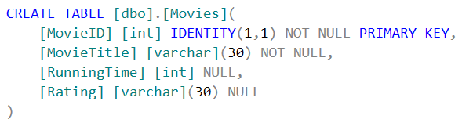
Here’s the SQL Syntax
[dbo] is the owner of the table.
All tables must have an owner. DBO is a special schema called “database owner”.
Most times this is the default and what you will find in the wild, sometimes in high security scenarios different roles are assigned as owners

Slide 18
SQL Data Types (Text)
Data Type | Description | Size
Char(n) | Fixed-length character string. Max 8,000 characters | n bytes
Varchar(n) | Variable-length character string, Max 8,000 characters | 1 byte per character + 2 bytes overhead
Varchar(max) | Variable-length max 1,073,741,824 characters | 1 byte per character + 2 bytes overhead
Text | Vaariable-length max 2GB of text data | 1 byte per character + 2 bytes overhead
XML | XML formatted data up to 2GB in size
* There is also nchar, nvarchar, and ntext which store Unicode characters
and binary, varbinary, and image which store Binary data

Slide 19
SQL Data Type (Numeric)
Data Type | Description | Size
Bit | True/False stored as 0/1
Tinyint | 0 to 255 | 1 Bytes
SmallInt | -32,768 to 32,767 | 2 Bytes
Int | -2,147,483,648 to 2,147,483,647 | 4 Bytes
Bigint | -9,223,372,036,854,775,808 to 9,223,372,036,854,775,807 | 8 Bytes
Decimal(p,s) | Fixed precision and scale numbers -10^38 to 10^38-1 P is the max number of digits (left and right) S is the number of digits to the right of the decimal point | 5-17 bytes

Slide 20
SQL Data Type (Numeric)
Data Type | Description | Size
Smallmoney Money | In legacy versions these were for currency, these are deprecated and should be moved to decimal
Float(n) | Floating point precision -1.79E + 308 to 1.79E + 308 n determines 4 or 8 bytes. 24 for 4, 53 for 8. Default is 24 | 4 or 8 Bytes
Real | Floating point precision -3.40E + 38 to 3.40E + 38 | 4 Bytes
Uniqueidentifier | Not really numeric, it’s a GUID (globally unique identifier). Useful for multiple database syncing scenarios | 16 Bytes

Slide 21
SQL Data Type (Date And Time)
Data Type | Description | Size
datetime | Jan 1, 1753 to Dec 31, 9999 Accuracy of time to 3.33 milliseconds | 8 Bytes
Datetime2 | Jan 1, 0001 to Dec 31, 9999 Accuracy of time to 100 nanoseconds | 6-8 Bytes
Smalldatetime | Jan 1, 1900 to June 6, 2079 with an accuracy of 1 minute | 4 Bytes
Date | Jan 1, 0001 to Dec 31, 9999 | 3 bytes
Time | Time only, 100 nanoseconds precision | 3-5 bytes
Datetimeoffset | Same as datetime2 but with time zone offset info | 8-10 bytes
Timestamp | Unique number that gets updated every time a row is created or modified. Used for concurrency/auditing | 8 Bytes

Slide 22
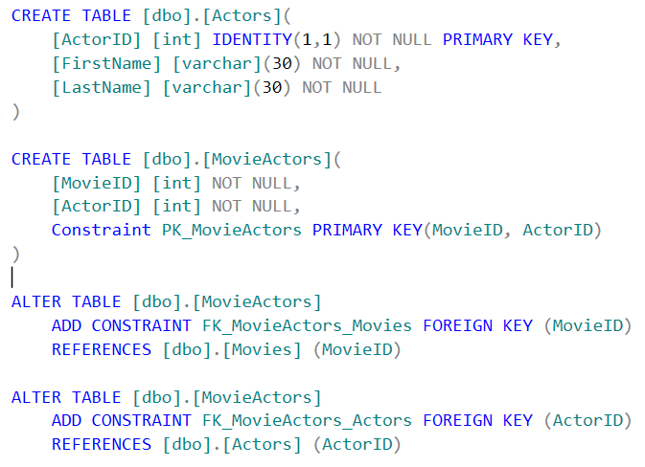
Combo Keys And Foreign Keys
As mentioned earlier, we can have combination primary keys, typically in many-to-many relationships
Foreign Keys put a constraint on the table that a key field must exist in the table that it references
In this example our movies can have many actors, and actors can belong to many movies. This is a classic many-to-many relationship.
We handle this by creating a join table to handle the cross references. Notice that MovieActors is a combination key, that is an actor can only be in a movie one time, but can be in many movies
Notes:
MySQL uses Auto_Increment
CREATE TABLE Orders ( O_Id int NOT NULL, OrderNo int NOT NULL, P_Id int, PRIMARY KEY (O_Id), FOREIGN KEY (P_Id) REFERENCES Persons(P_Id) )

Slide 23
Demo
Now let’s do it using the database designer

Slide 24
Fin
Next up- Data Modification Queries!

